Slide 1
Welcome
Industry Feedback Roundtable

Slide 2
Today’s Agenda

Slide 3
First, a recap
Where we are…

Slide 4
Motor injury claims year on year – market level
Jan/Feb 2020
Covid effect
May 2021
OIC launches

Slide 5
Monthly claim volumes
There is a consistent comparison of 3 in 4 cases going into the OIC portal. CPL will continue to see new claims based on value limits (£5/10000 thresholds) and for OIC carve outs e.g. pedestrians/cyclists/minors.
Notes:
NEED CPL

Slide 6
Snapshot status
Pending new/liability decision: A new claim pending entry or awaiting a liability decision to be made
Liability Denied: A claim where liability for the accident has been denied
Awaiting Medical Upload: Status achieved as liability admitted, waiting on the medical to be uploaded
Active Negotiation: Claim presented and being actively negotiated – offer flows/causation/ losses
Claims Exiting: A claim that is no longer in the portal
Settled Cases: This means cases where settlement has been agreed and paid to the claimant

Slide 7
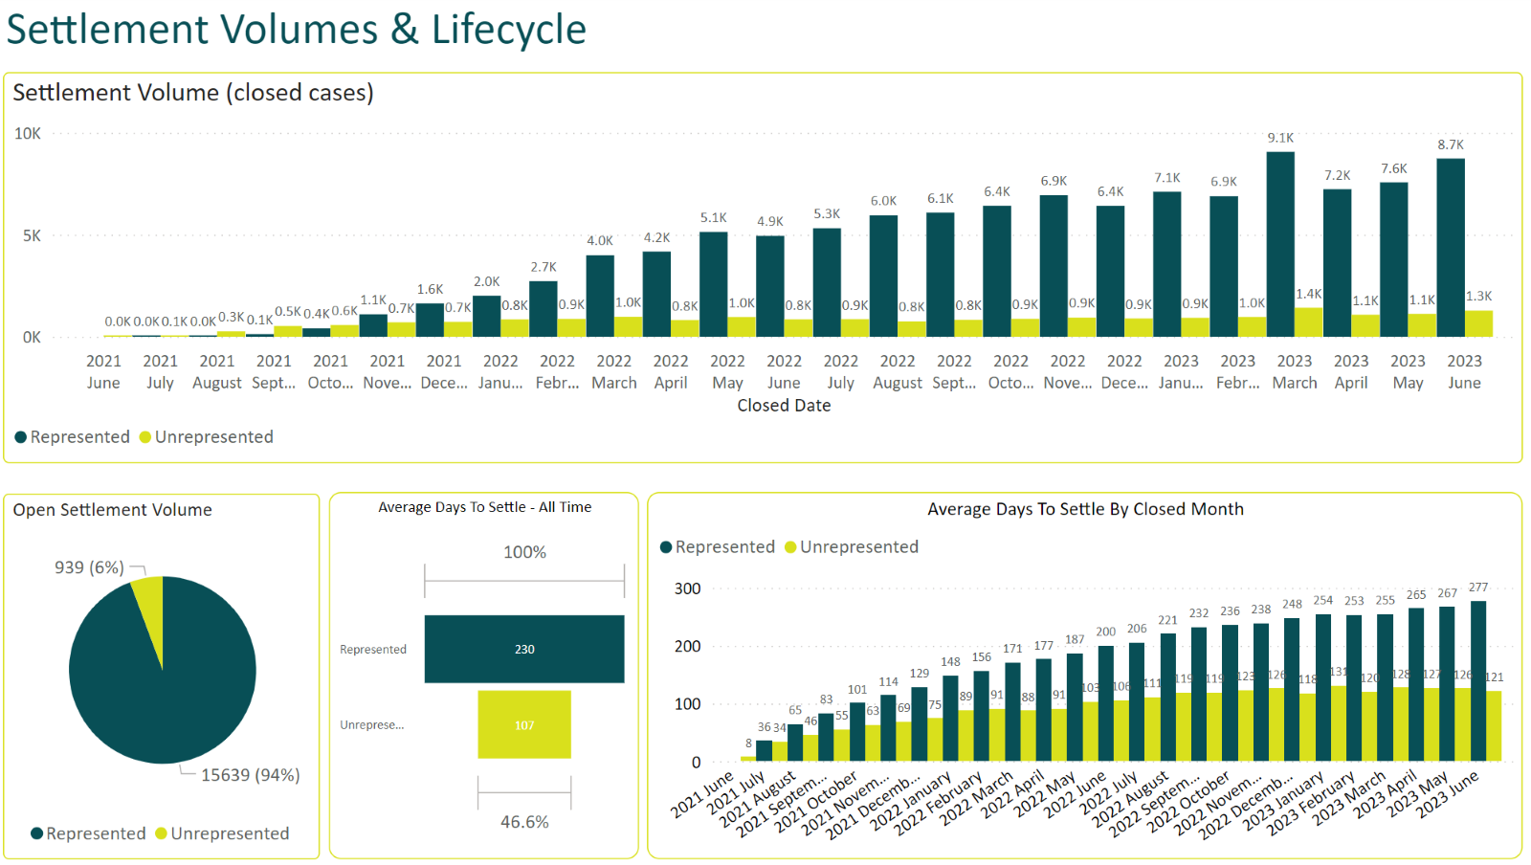
Settlement Volume & Lifecycle

Slide 8
Snapshot status – a detailed view
A snapshot is exactly that – a moment in time. The data in the system moves constantly with over 500 users routinely transacting within the portal. The illustration used below highlights how a cohort of c100,000 claims in April 2022 which have progressed in the portal over time. They are not “stuck”, they move towards negotiation, settlement or exiting as soon as the medical is shared and the case presented. We have already started to triangulate this data to better understand throughput and how it changes over time.

Slide 9
Feedback ...The big themes

Slide 10
OIC Help Hub
Visit our Help Hub and explore the content available here: www.officialinjuryclaim.org.uk/help-hub

Slide 11
Previous Feedback
Here are the high-level themes taken from across the previous claimant and defendant roundtable sessions:
Improve the claimant’s journey when liability is disputed
Consider issue with going to court multiple times on the same claim
Permit recoverable counsel fees
Medical journey should be similar to LIP (Litigant in Person) to ensure timely medicals and transparency
Improve transfer process between compensators and TPAs (third party administrators)

Slide 12
Let’s take a break
Time to refresh

Slide 13
Open Floor

Slide 14
What's next?
14

Slide 15
Power BI embedded
See what we see…as we see it
15

Slide 16
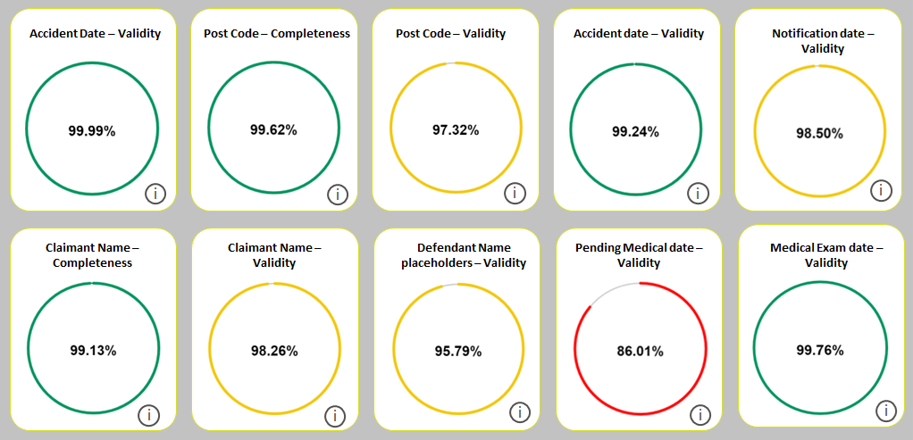
Data quality
16

Slide 17
The cadence of a code release drop at 6 monthly intervals has been adopted since Nov 2021. Code dealing with a primary limitation count down releases in November 2023. Beyond that there are currently no significant new releases in the pipeline. We will continue with a regime of bug maintenance and small releases. We are presently considering moving to one code drop in 2024 and intend to reach out to the API community to discuss that. There is a natural tension between change and enhance (and funding) vs stasis.
2024 plan & release cadence

Slide 18
Thank you
Industry Feedback Roundtable

